Slide 1
Air-Conditioning - Terminology

Slide 2
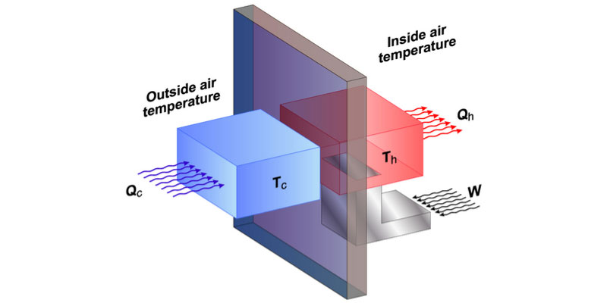
Important Terms
Refrigeration Cycle
Evaporation
Compression
Condensation
Refrigerant
Cooling Capacity

Slide 3
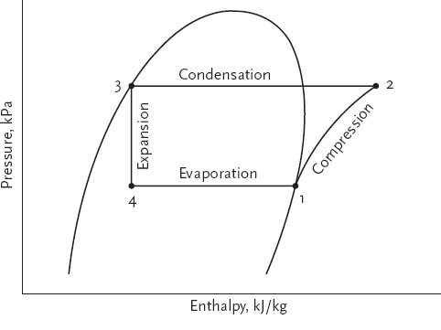
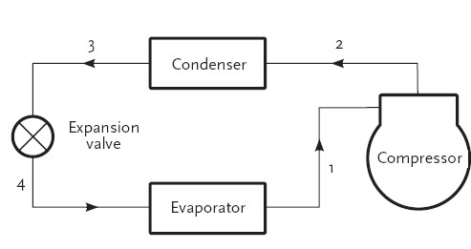
Refrigeration Cycle
A Closed cycle of evaporation, compression, and condensation.
Transfer of Heat energy between two environments.

Slide 4
Evaporation
The process of liquid becoming vapor/gas and it takes place in evaporator coil of an air-conditioner.
This part of the system gets cold to the touch (about 7°C/ 45°F) during it’s operation.

Slide 5
Compression
The process of reducing the volume of a gas/ vapor is called compression.
The compressor pumps gaseous refrigerant to a high pressure and temperature.

Slide 6
Condensation
The process of gas turning into liquid state is called condensation
It allows refrigerant to transfer heat without mixing.

Slide 7
Refrigerant
The working fluid in refrigeration cycle is called refrigerant.
Modern AC's hydro flouro carbons that are inflammable, non-corrosive.
Most widely used refrigerant in residential AC's nowadays are R32.

Slide 8
Cooling Capacity - Units
Ton | Kilo Watts | BTUs/hr
01 | 3.6 | 12,000
BTU or British thermal unit is generally used to measure Cooling capacity.
It can also be measured in Tons and Watts

Slide 9
Quiz
01 Ton is equal to?
a) 120 Btus/hr.
b) 1,200 Btus/hr.
c) 12,000 Btus/hr.
d) 120,000 Btus/hr.

