Slide 1
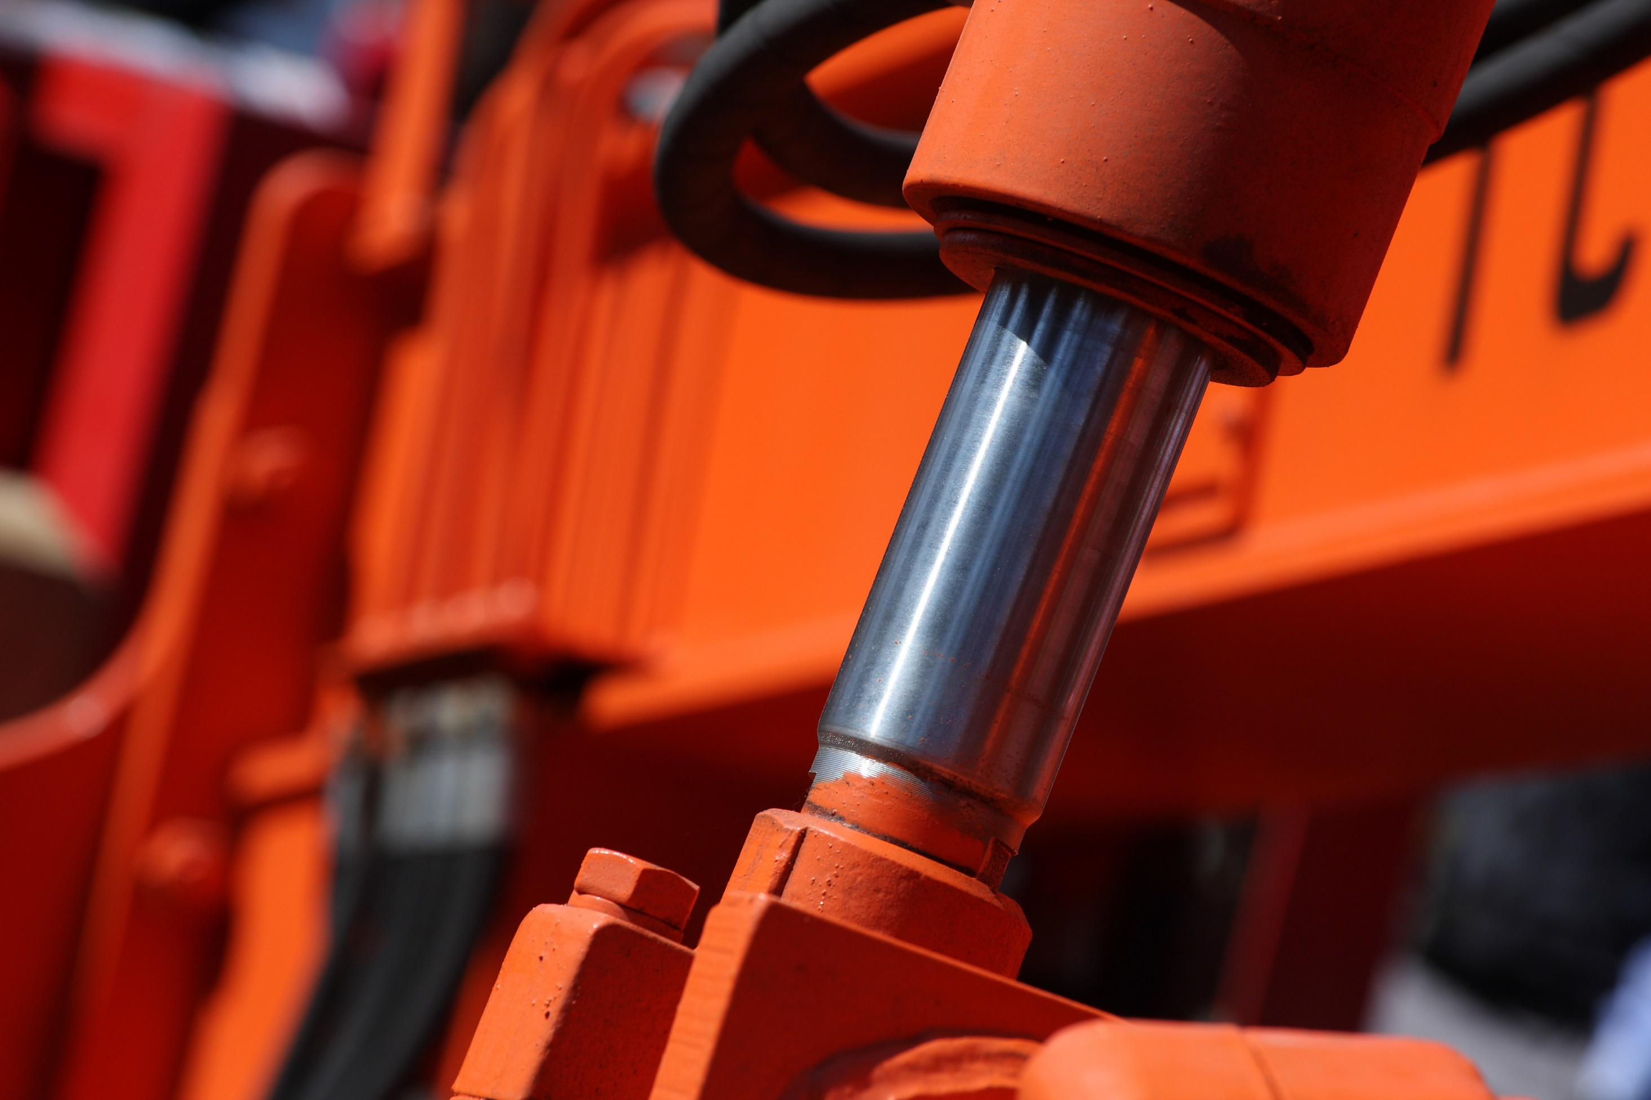
HYDRAULIC TERMINOLOGY

Slide 2
Force
Force is the process of pulling or pressing on an object.
Force can cause an object to move, stop, change its speed or direction.
According to Newton's Law, Force = mass x acceleration is F = m.a.

Slide 3
Pressure
The ratio of force which is exerted on a certain/ specific area is called pressure.
Pressure of liquids does not depend on the shape of the container.
Pressure = Force/ Area

Slide 4
Area
Refers to the area where the pressure is applied.
The base of the closed container can be expressed as the piston surface on which pressure is generated or the piston surface on which pressure is applied.
Pressure and force can be increased or decreased depending on the size of the area.

Slide 5
Thrust Force
When the pushing force is applied to the liquid in the closed container by the piston rod of the piston having a certain cross-sectional area, the pressure of the liquid increases.
Pressure increases with increasing thrust force, pressure decreases with increasing piston cross-sectional area.

Slide 6
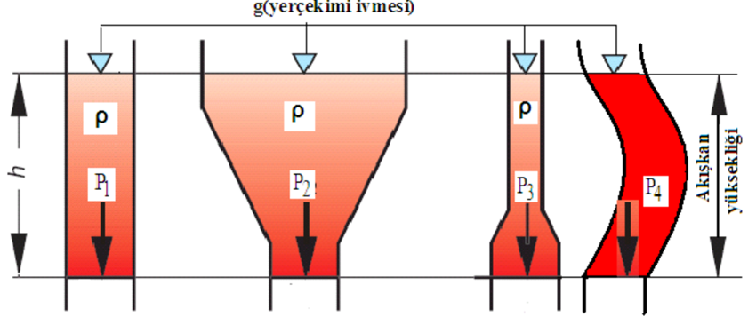
Hydro Static Principle
Liquids in any container apply pressure to the bottom of the container.

Slide 7
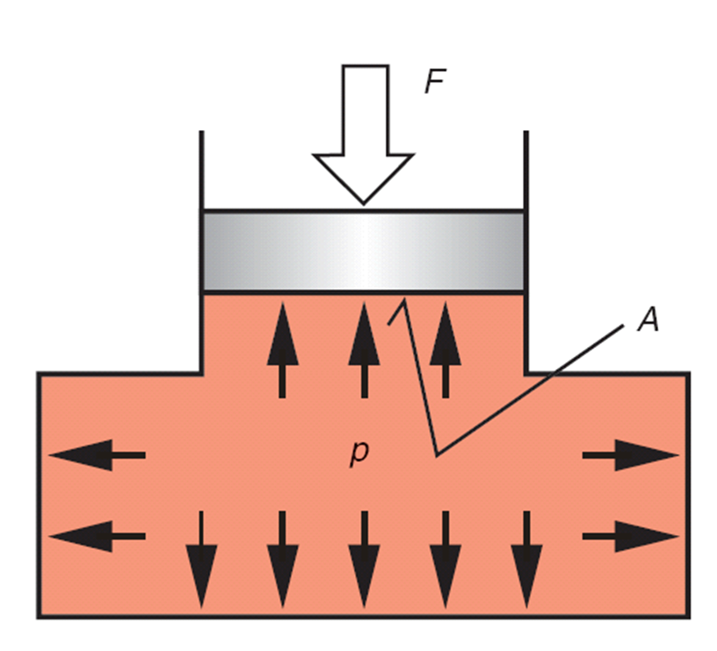
The second of the hydrostatic principles is also called Pascal's Law.
According to Pascal's Law, the pressure generated by a force applied to a container filled with liquid is transmitted by the liquid to all surfaces of the container.

Slide 8
Work
The force exerted over a distance indicates the work performed.
Since Work = Force x Path, work units are equal to the product of force units and path (length) units.
1 joul = 1 Nm = 0,102 kgm
1 kgm = 10 joul

Slide 9
Power
Power is the rate at which work is done or the rate at which energy is transfered from one place to another or transformed from one type to another.
1 W = 0,00135 HP
1 HP = 735,5 W

Slide 10
Density
The pressure applied by the liquid to the bottom of the container varies depending on the height and density of the liquid.
For example, if two identical containers are filled with oil and one with water, the pressure applied to the bottom of the container is high in the case of oil due to its high density

Slide 11
Quiz
Which of the following is not one of the pressure units?
PSI
Newton
Bar
Pascal

Slide 12
HYDRAULIC TERMINOLOGY

