Slide 1
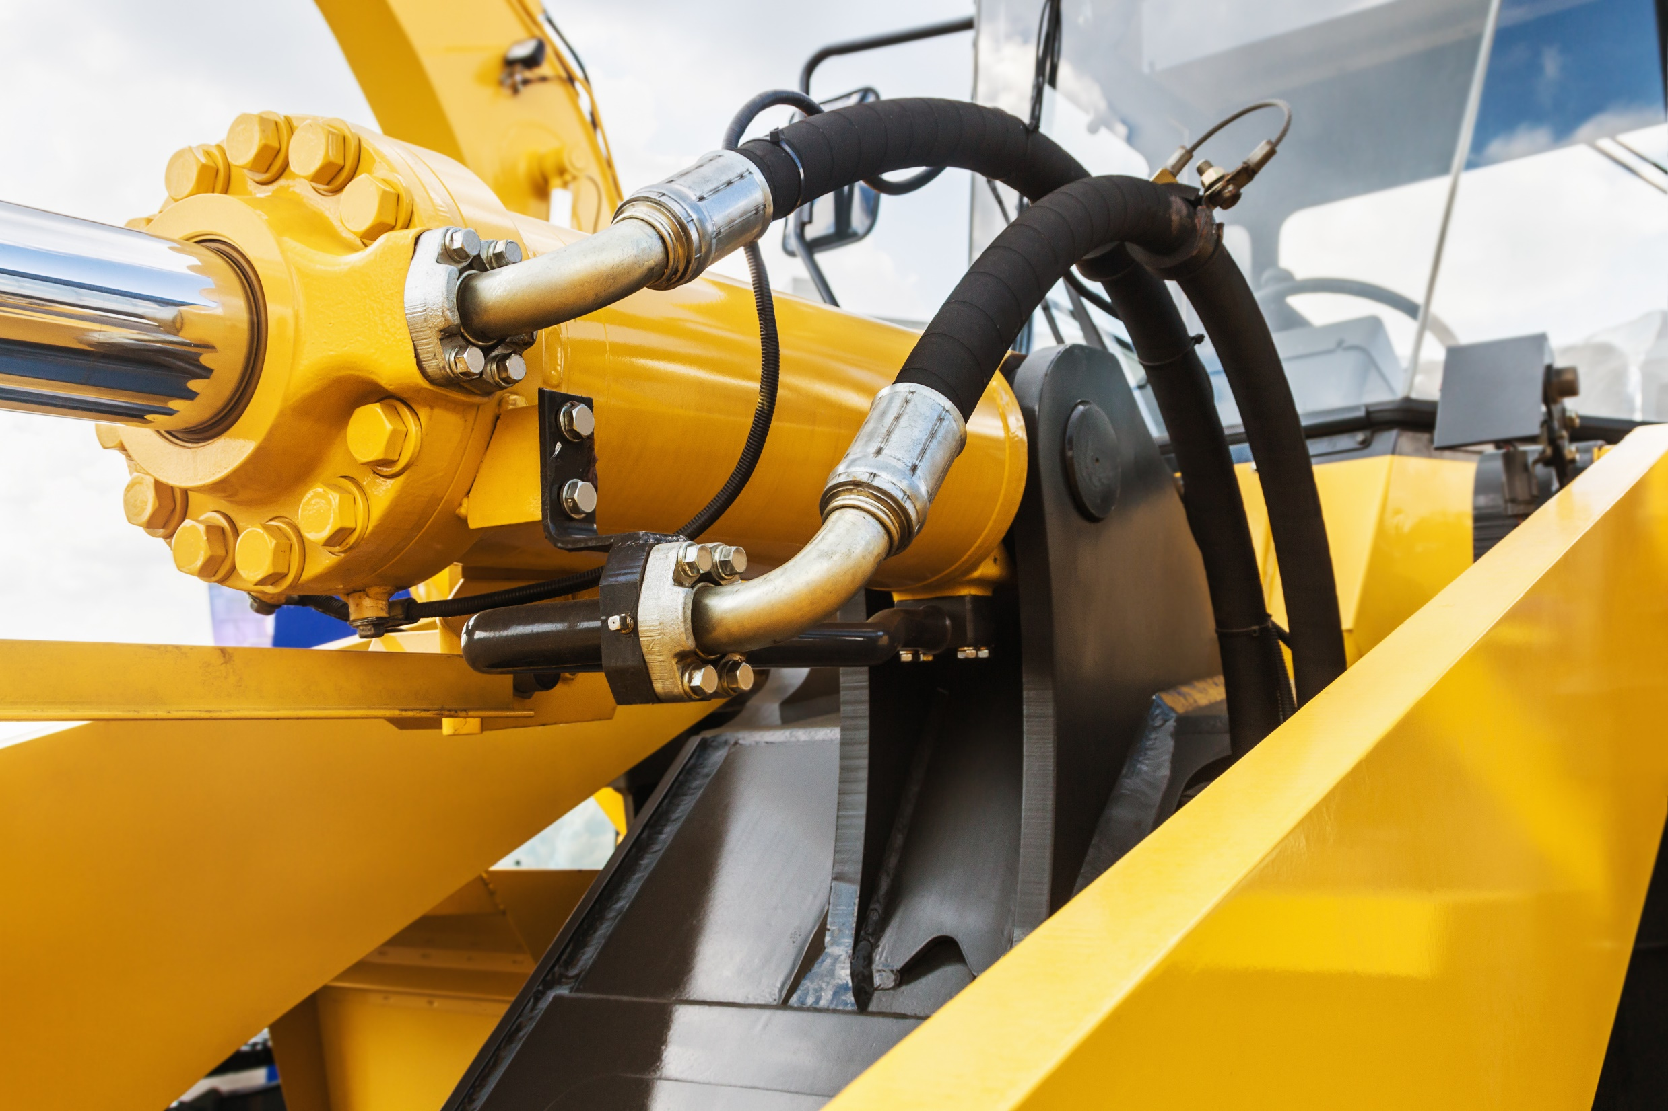
HYDRAULICS FUNDAMENTALS

Slide 2
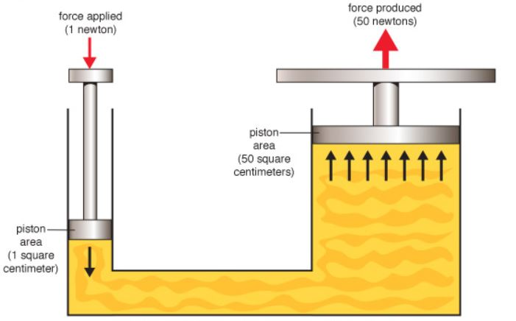
Working Principle
Pressure applied to any part of a confined fluid transmits equally to every other part in perpendicular direction without any loss.

Slide 3
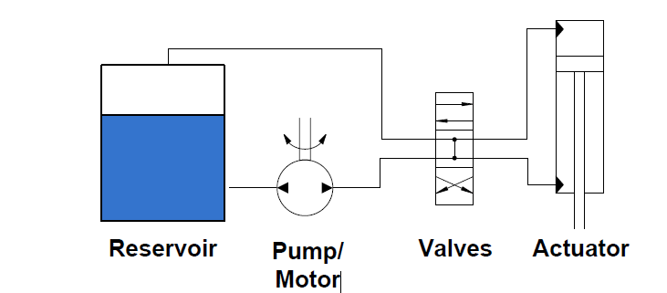
Hydraulic System - Schematic
Fundamentally every hydraulic system should consist of a reservoir, actuator, control valves and pipe hoses.

Slide 4
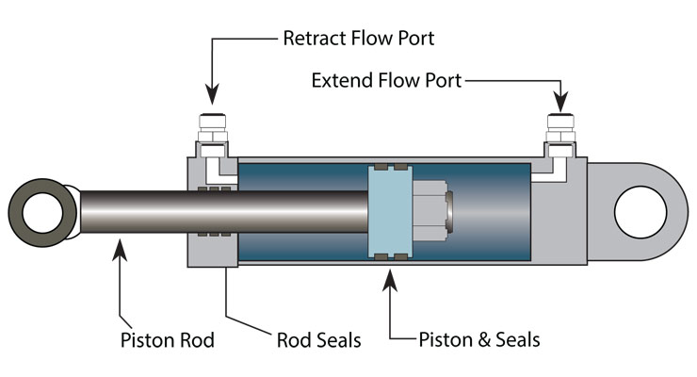
Hydraulic Cylinder - Components
Hydraulic Cylinders are used to convert fluid power into mechanical motion and its main components are as above

Slide 5
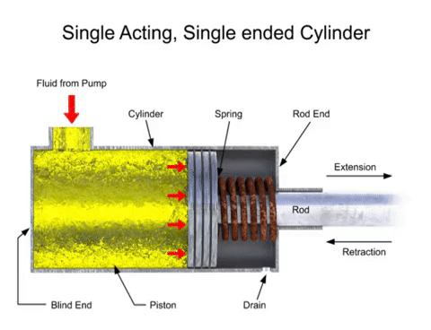
Single Acting Cylinders
Single Acting cylinders takes power stroke solely in single direction.
It either can develop force in forward stroke or backward stroke reckoning in its construction.

Slide 6
Double Acting Cylinders
In a double acting cylinder working fluid acts simultaneously on both sides of the piston.
Retraction and extension is achieved at each end of the port which is supplied with hydraulic fluid.

Slide 7
Hydraulic Fluid
It plays a vital role in hydraulic system.
Hydraulic fluid is the medium by which power is transferred in the system.
Hydraulic cylinders will work more efficiently if the hydraulic fluid has zero compressibility.

Slide 8
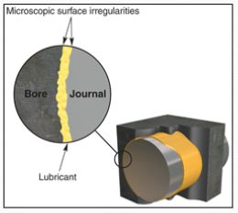
Hydraulic Fluids – Characteristics
Viscosity: It is an internal resistance to the flow of the fluid.
Viscosity: should neither be too high nor be too low.
Lubrication: It reduces friction between two surfaces.
Chemical Stability: It helps in resisting oxidation.

Slide 9
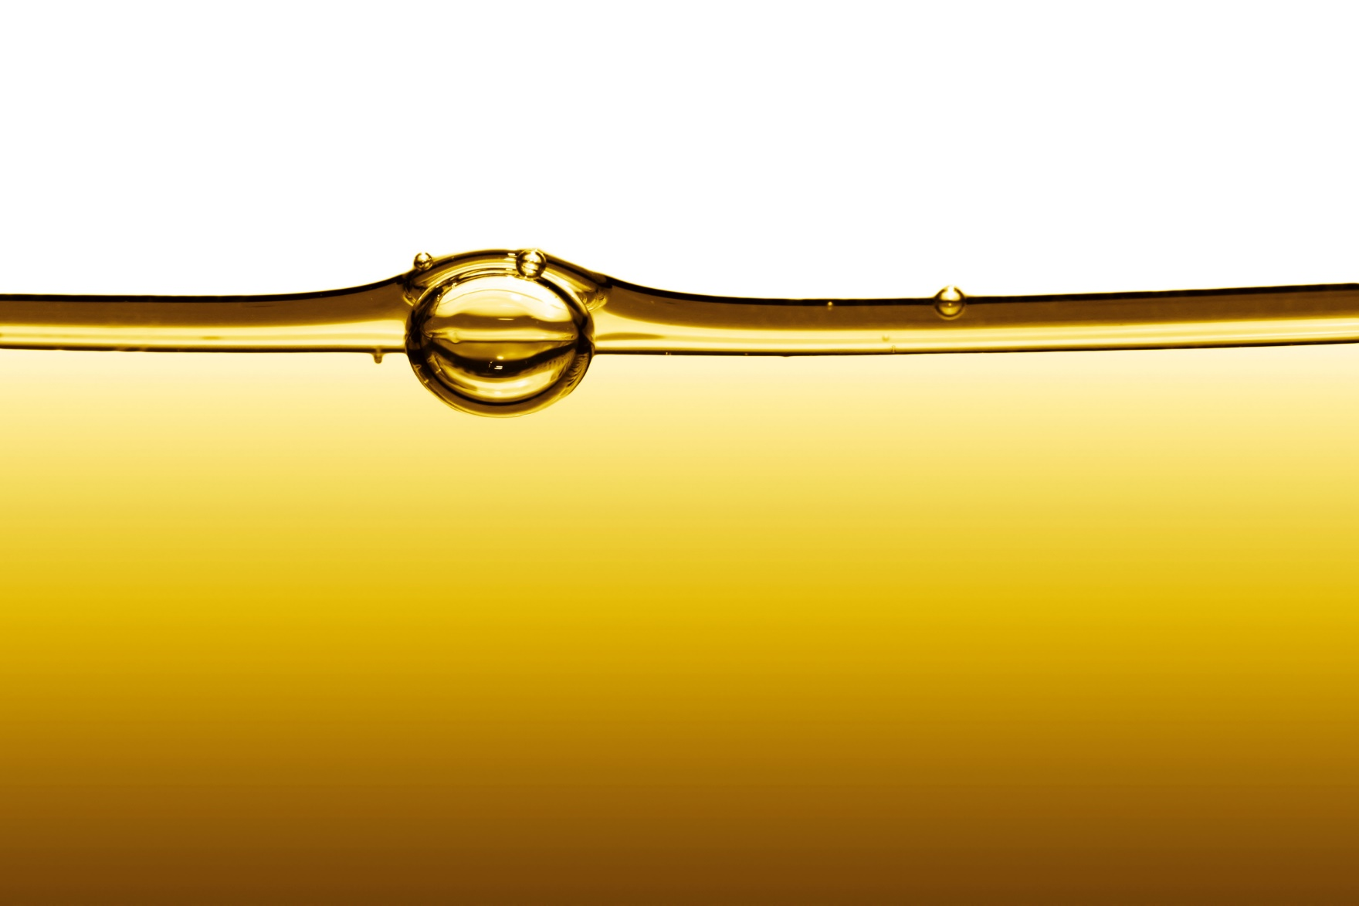
Hydraulic Fluids - Types
Petroleum based/ Mineral Based These fluids have oil base, higher performance at lower cost.

Slide 10
Hydraulic Fluids - Types
Water Based/ Fire Resistant These are mainly used in industries where there is a chance of any hazards. Generates less heat compared to other variants.

Slide 11
Hydraulic Fluids - Types
Synthetic Fluids These are also called as man made fluids using raw materials syntesized by chemically modified components or crude oil.

Slide 12
Quiz
A good hydraulic fluid should have?
Low viscosity, high lubrication.
High viscosity, poor chemical stability.
Good viscosity, high chemical stability.
High chemical stability, low lubrication.

Slide 13
HYDRAULICS FUNDAMENTALS

