Slide 1
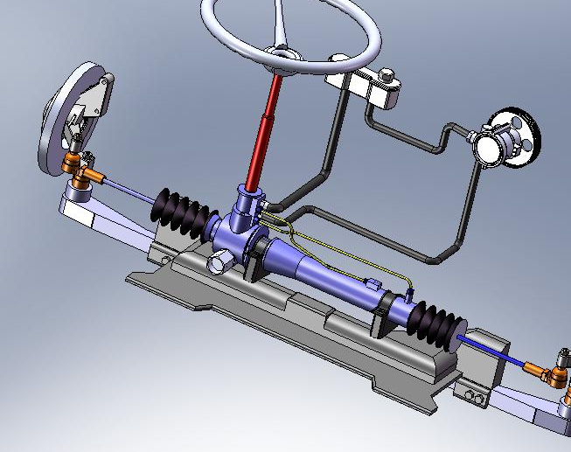
HYDRAULIC POWER STEERING SYSTEM (HPS)

Slide 2
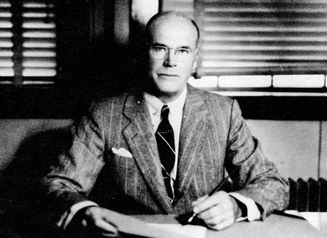
HISTORY
Power steering have been around for a very long time, like hundred years long. The first ever hydraulic power steering was awarded a patent in 1876. It was then improved by Frederick W. Lanchester in 1902.
In 1926, Francis Davis became the first person to successfully fit a hydraulic power steering unit into a automobile.
Francis Davis is the father of hydraulic power steering.

Slide 3
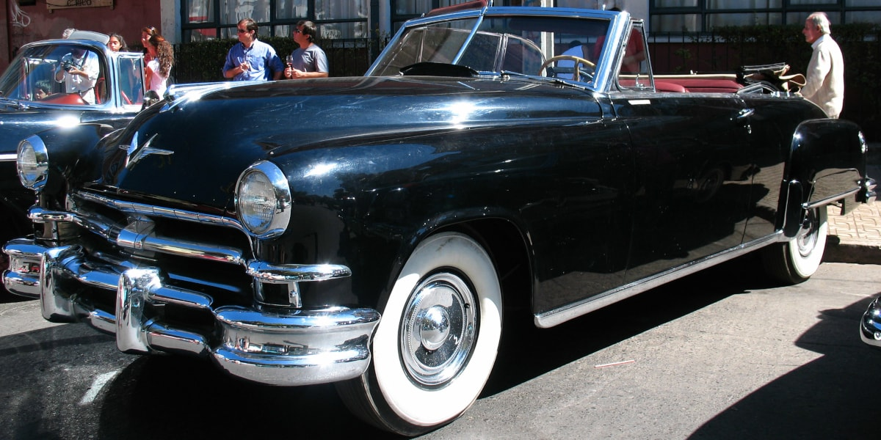
HISTORY
In 1951, Chrysler is the first car manufacturer to make power steering unit commercially available. It was available to the public through their passenger car – the Chrysler Imperial.
Soon after, many other cars manufacturers such as General Motors, Toyota and Honda quickly came up with their own variation of power steering and implemented them. And that brings us to where we are now. In 21st century, virtually all cars are now equipped with power steering.
Chrysler Imperial 1951 is the first commercial passenger car that is equipped with a hydraulic power steering unit.

Slide 4
BASIC STEERING SYSTEM

Slide 5
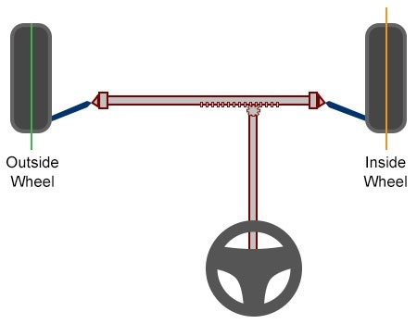
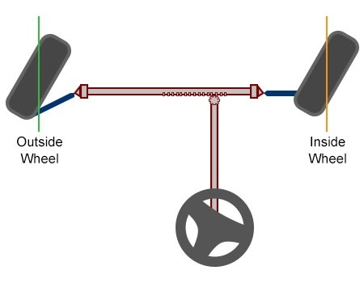
BASIC STEERING SYSTEM
These 3 components work together to give you the ability to steer your car.

Slide 6
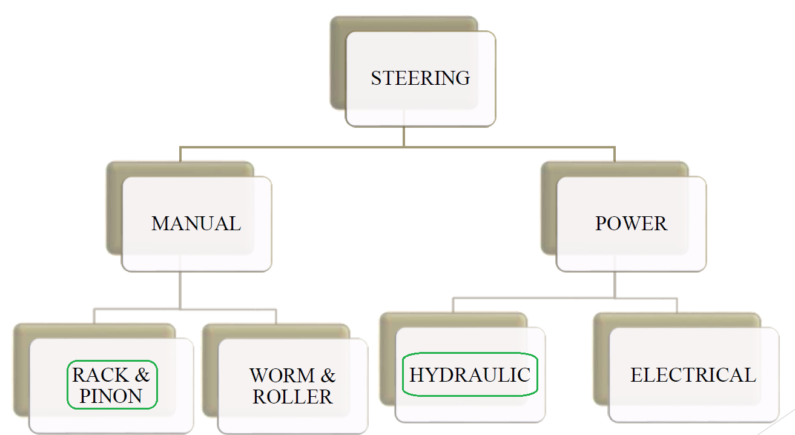
TYPES OF STEERING SYSTEMS

Slide 7
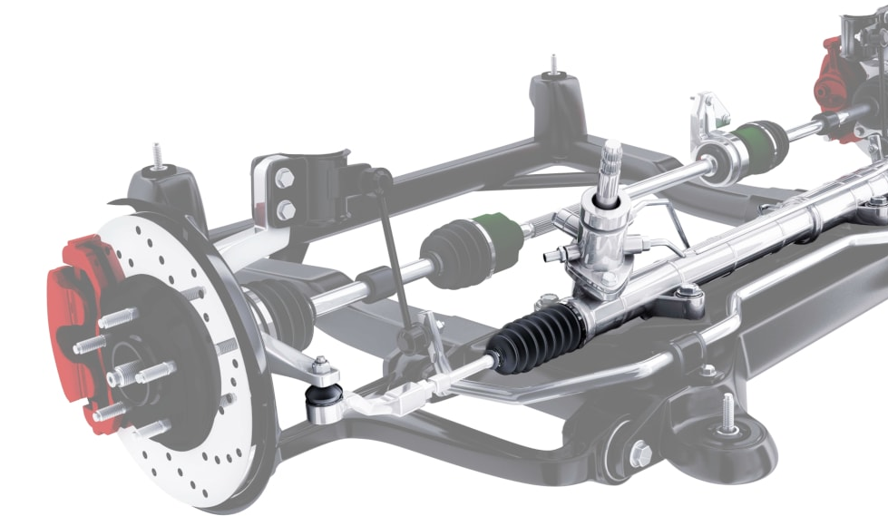
HYDRAULIC POWER STEERING (HPS)
The hydraulic power steering system is a closed loop system that uses pressurized hydraulic fluids for changing the wheel angle of front wheels based on steering angle.
It contains a hydraulic pump driven by a belt, valves, cylinder, reservoir and a driver control mechanism(rack & pinion/steering gearboxes).

Slide 8
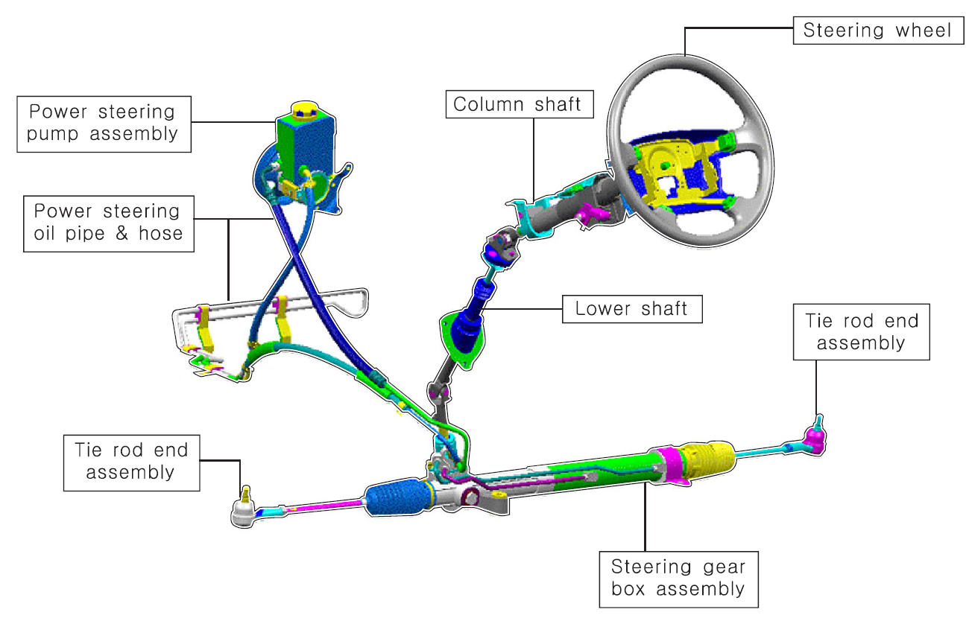
HYDRAULIC POWER STEERING

Slide 9
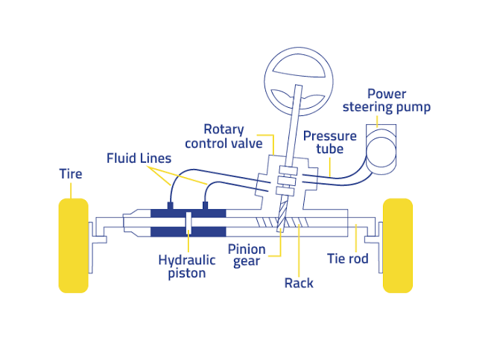
HYDRAULIC POWER STEERING(HPS)
Hydraulic power steering have a few additional parts to supply the extra power. We are talking about :
Hydraulic fluid
Steering fluid reservoir
Steering pump
Rotary Valve
Hydraulic Chamber

Slide 10
Hydraulic fluid
A hydraulic fluid or hydraulic liquid is the medium by which power is transferred in hydraulic machinery. Common hydraulic fluids are based on mineral oil.
Power steering fluid is a sub type of hydraulic fluid. Most are mineral oil or silicone based fluids, while some use automatic transmission fluid, made from synthetic base oil.
Use of the wrong type of fluid can lead to failure of the power steering pump.

Slide 11
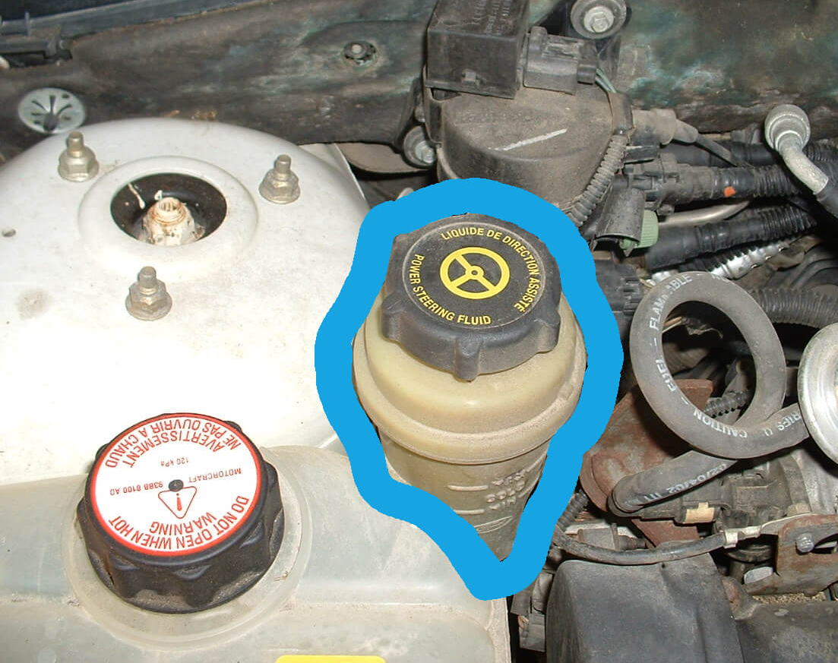
Steering fluid reservoir
It holds the fluid, and supplies them to the steering pump through rubber hoses.

Slide 12
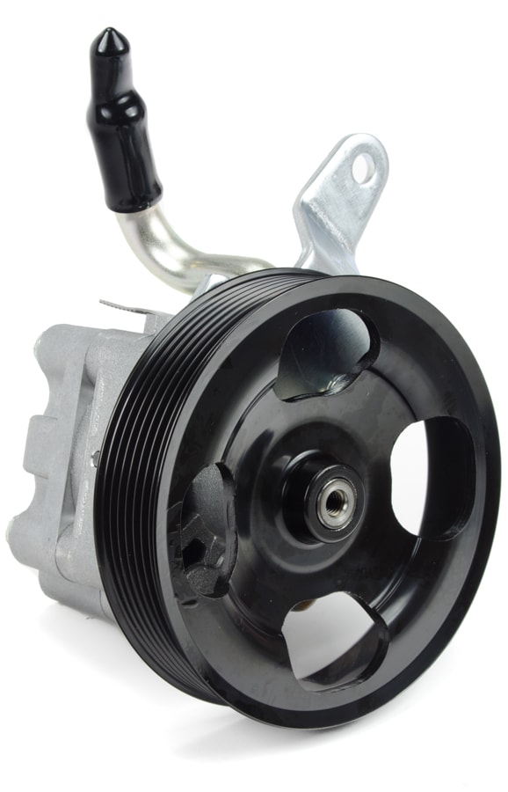
Steering pump
When car’s engine is running, the engine belt turns in a loop and that also turns the steering pump. With that, the pump pulls the steering fluid from the steering fluid reservoir and pressurizes them.
We put low pressure steering fluid in, and high pressure steering fluid comes out of the other end. These high pressure steering fluid then leaves the steering pump, through the steering hoses and into the steering rack, specifically into the rotary valve.

Slide 13
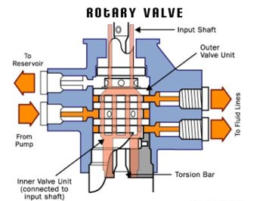
Rotary Valve
A rotary valve is a highly sensitive metal casing with strategically placed holes that redirects the steering fluid either back to the steering pump or into the steering rack.
If the steering wheel is in its original position, the rotary valve redirects the steering fluid back to the steering pump and nothing happens. The cycle of steering fluid moving from reservoir to pump and to rotary valve just keeps repeating itself.
But when the driver turns the steering wheel, the rotary valve opens up and steering fluid from the steering pump gets redirected. This time, it doesn’t go back to the steering pump but it exits the rotary valve through the fluid lines and into one of the hydraulic chamber of the steering rack.

Slide 14
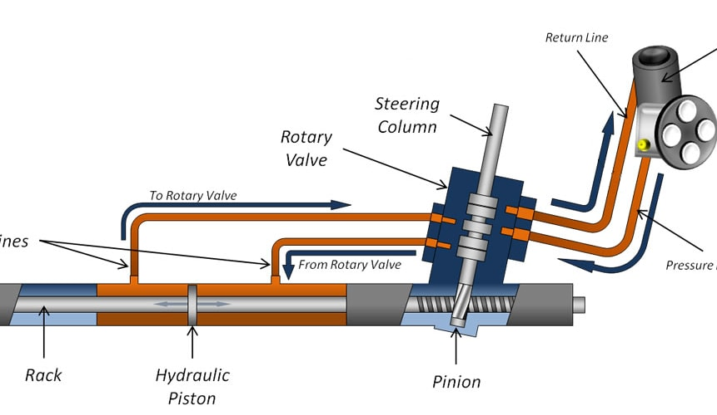
Hydraulic Chamber
When there is more steering fluid on one side of the hydraulic chamber, it creates a pressure differential across the chamber. The steering fluid then pushes the hydraulic piston towards the weaker side of the hydraulic chamber and the steering rack moves accordingly.

Slide 15
REFERENCES
https://dsauto.com.my/en/2018/11/19/car-steering-system/#basic-car-steering-system-component
https://dsauto.com.my/en/2018/11/27/hydraulic-power-steering-explained/
https://hydraulicsuspension.com/hydraulic-power-steering/
https://tr.wikipedia.org/

